Slide 1
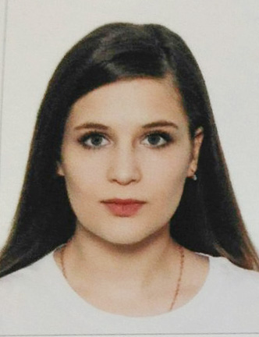
Valeriia Sukhacheva

Slide 2
EDUCATION
The Herzen State Pedagogical University of Russia St.Petersburg 2017–2021
Bachelor of Computer Science and Engineering. Profile: Software Development Technologies.

Slide 3
SKILLS
Computer: Adobe Lightroom, Adobe Photoshop, AutoCAD, Qt designer, Microsoft Office: Word, Excel, Access, Publisher, PowerPoint, PyCharm, Texmaker
Programming language: C, Python, js
Language: English

Slide 4
ENGINEERING EXPERIENCE
Construction company “Setl Group” St.Petersburg 1.07.19—28.08.19
Trainee Assistant in the OpenText Solutions Group
- study of projects developed by the group
- learning new site development tools

Slide 5
ENGINEERING PROJECTS
Project Simulator for numerical methods for solving linear algebra problems
- Selection of operation on matrices: matrix multiplication, finding the roots of systems of linear equations by the Gauss method, the transposition of a matrix, to find the roots of systems of linear algebraic equations by the method of triangular factorization;
- Selection of the matrix decomposition option of the system, if the triangular factorization method is selected;
- Conducting a computational experiment to study the characteristics of a numerical method and algorithms for its implementation.

Slide 6
PERSONAL QUALITIES
Responsibility, commitment, punctuality, efficiency, timely and accurate performance of their duties, fast learning, the desire to master new skills and abilities for professional and personal growth.

